Slide 1
Help at a time of crisis October 2020

Slide 2
About Us
We’re local charities – 5 in East Sussex – part of the national organisation
We’re mostly staffed by volunteers – 90% - and a small team of paid staff
We give general advice on most subjects and specialist advice on debt and benefits
We campaign o improve the policies and practices which affect people’s lives

Slide 3
Lockdown – what we did
Rapid switch to home working
Staff and volunteers
Advice via phone, email and webchat
Universal Credit Help to Claim
Benefits and Debt Casework

Slide 4
Our achievements so far…
Since lockdown started, in East Sussex we have:
Advised 9,217 clients
on 30,176 advice issues
Helped clients raise income of £3.9 million – benefits, refunds, wages owed, deposits refunded etc
Written off debts equalling £645,724
Top subjects – Benefits inc Universal Credit Employment Debt Housing Utilities & Communications

Slide 5
Employment Advice
The furlough scheme
The self-employed support scheme
Redundancy
Universal Credit
Returning to work issues – safety, shielding etc
Few sources of help with employment rights issues – ACAS, Trade unions

Slide 6
What changed?
Citizens Advice – help at a time of crisis
Fewer debt enquiries – recovery action on hold
Fewer housing enquiries – evictions on hold
“Kicking the can down the road”
Living off credit?
Consumer enquiries
Massive impact on statutory services – DWP, Councils, Court Service, Employment tribunals etc

Slide 7
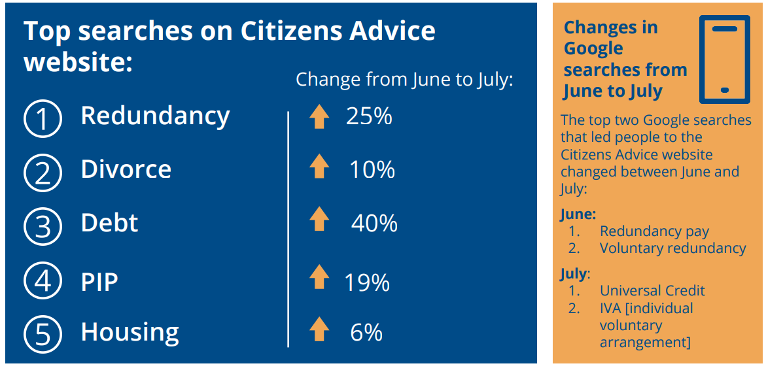

Slide 8
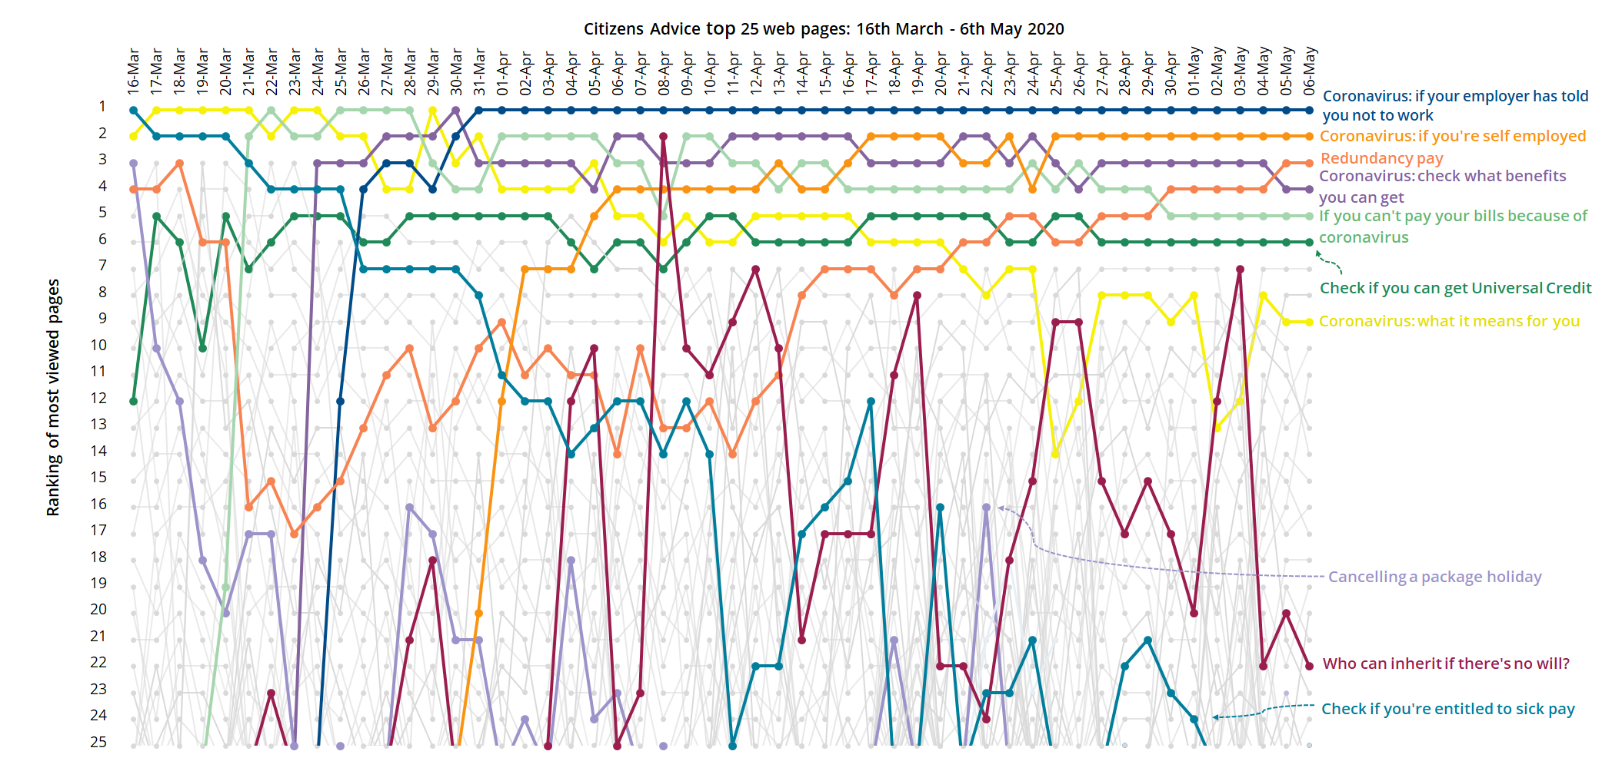

Slide 9
Campaigns
As well as giving advice we campaign on issues which affect our clients and seek to bring about improvements to the policies and practices which affect people’s lives
Government Support schemes
Employment rights
Benefits
Housing / homelessness

Slide 10
Parents, carers and disabled people at least twice as likely to face redundancy, warns Citizens Advice
Citizens Advice has found that parents, carers, disabled people whose disability has a large impact on their day-to-day life, and those who previously shielded, are at least twice as likely to face redundancy as the rest of the working population.
One in six (17%) of the working age population facing redundancy those in more vulnerable circumstances are likely to bear the brunt.
The charity’s survey of 6,000 people shows:
One in four disabled people (27%) were facing redundancy. This rose to 37% of those who said their disability has a large impact on their day-to-day life.
Half of those who were in the shielded group (48%), as they were extremely clinically vulnerable to coronavirus, were at risk of redundancy
Two in five parents or carers (39%) faced losing their job

Slide 11
What’s next?
Increasing our Debt capacity
Debt and Benefits Advice for mental health
Improving access for BAME communities
Recruiting and training more “virtual volunteers”
More training on employment issues
Continuing to campaign for change
housing rights including temporary accommodation and homelessness
employment rights
financial support including welfare benefits

Slide 12
Contact us
East Sussex Adviceline - 03444 111 444
Send a message via www.eastsussexcab.co.uk
Warm Home Check Service www.warmhomecheckservice.org
Citizens Advice Consumer Helpline - 0808 223 1133
Universal Credit Help to Claim – 0800 144 8 444
citizensadvice.org.uk – webchat for UC and Debt

